Slide 1
Drawings
(Some Types)
Portraits
( human faces,
expressions etc.)
Botanical Drawings
( plants, flowers etc.)
Nature Drawings
( landscape,
scenery etc.)
Geographical
Drawings
( maps etc.)
Zoological Drawings
(creatures, animals etc.)
Engineering Drawings,
(projections.)
Building Related Drawings.
Machine component Drawings
Orthographic Projections
(Fv,Tv & Sv.-Mech.Engg terms)
(Plan, Elevation- Civil Engg.terms)
(Working Drawings 2-D type)
Isometric ( Mech.Engg.Term.)
or Perspective(Civil Engg.Term)
(Actual Object Drawing 3-D)

Slide 2
ORTHOGRAPHIC PROJECTIONS:
IT IS A TECHNICAL DRAWING IN WHICH DIFFERENT VIEWS OF AN OBJECT
ARE PROJECTED ON DIFFERENT REFERENCE PLANES
OBSERVING PERPENDICULAR TO RESPECTIVE REFERENCE PLANE
Different Reference planes are
Horizontal Plane (HP),
Vertical Frontal Plane ( VP )
Side Or Profile Plane ( PP)
And
Different Views are Front View (FV), Top View (TV) and Side View (SV)
FV is a view projected on VP.
TV is a view projected on HP.
SV is a view projected on PP.
IMPORTANT TERMS OF ORTHOGRAPHIC PROJECTIONS:
1
Planes.
Pattern of planes & Pattern of views
Methods of drawing Orthographic Projections
2
3

Slide 3




1
PLANES
PRINCIPAL PLANES
HP AND VP
AUXILIARY PLANES
Auxiliary Vertical Plane
(A.V.P.)
Auxiliary Inclined Plane
(A.I.P.)
Profile Plane
( P.P.)

A.V.P.
A.I.P.
⊥ to Hp & ∠ to Vp
⊥ to Vp
&
∠ to Hp


Slide 4
2
PATTERN OF PLANES & VIEWS (First Angle Method)
THIS IS A PICTORIAL SET-UP OF ALL THREE PLANES.
ARROW DIRECTION IS A NORMAL WAY OF OBSERVING THE OBJECT.
BUT IN THIS DIRECTION ONLY VP AND A VIEW ON IT (FV) CAN BE SEEN.
THE OTHER PLANES AND VIEWS ON THOSE CAN NOT BE SEEN.
Y
PROCEDURE TO SOLVE ABOVE PROBLEM:-
TO MAKE THOSE PLANES ALSO VISIBLE FROM THE ARROW DIRECTION,
A) HP IS ROTATED 90⁰ DOUNWARD
B) PP, 90⁰ IN RIGHT SIDE DIRECTION.
THIS WAY BOTH PLANES ARE BROUGHT IN THE SAME PLANE CONTAINING VP.
X
Click to view Animation
On clicking the button if a warning comes please click YES to continue, this program is
safe for your pc.
Y
VP
PP
FV
LSV
X
Y
X
TV
HP
ACTUAL PATTERN OF PLANES & VIEWS
OF ORTHOGRAPHIC PROJECTIONS
DRAWN IN
FIRST ANGLE METHOD OF PROJECTIONS
HP IS ROTATED DOWNWARD 90⁰
AND
BROUGHT IN THE PLANE OF VP.
PP IS ROTATED IN RIGHT SIDE 90⁰
AND
BROUGHT IN THE PLANE OF VP.

Slide 5
3
Methods of Drawing Orthographic Projections
First Angle Projections Method
Here views are drawn
by placing object
in 1st Quadrant
( Fv above X-y, Tv below X-y )
Third Angle Projections Method
Here views are drawn
by placing object
in 3rd Quadrant.
( Tv above X-y, Fv below X-y )
SYMBOLIC
PRESENTATION
OF BOTH METHODS
WITH AN OBJECT
STANDING ON HP ( GROUND)
ON IT’S BASE.
FV
TV
X
Y
NOTE:-
HP term is used in 1st Angle method
&
For the same
Ground term is used
in 3rd Angle method of projections
X
Y
TV
FV
G
L

Slide 6
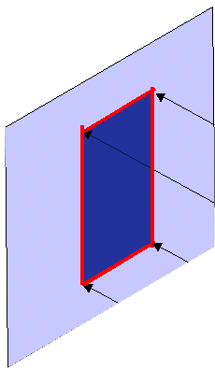
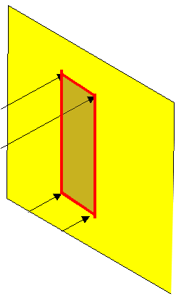
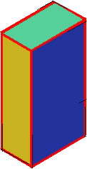
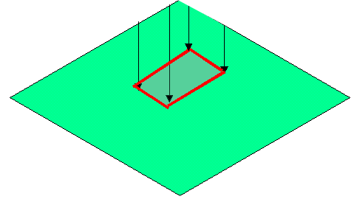


FIRST ANGLE
PROJECTION
FOR T.V.
IN THIS METHOD,
THE OBJECT IS ASSUMED TO BE
SITUATED IN FIRST QUADRANT
MEANS
ABOVE HP & INFRONT OF VP.
V.P.
P.P.
F.V.
S.V.
OBJECT IS INBETWEEN
OBSERVER & PLANE.
OBJECT
VP
PP
FV
LSV
X
Y
FOR S.V.
FOR F.V.
TV
HP
ACTUAL PATTERN OF
PLANES & VIEWS
IN
FIRST ANGLE METHOD
OF PROJECTIONS

Slide 7


THIRD ANGLE
PROJECTION
FOR T.V.
IN THIS METHOD,
THE OBJECT IS ASSUMED TO BE
SITUATED IN THIRD QUADRANT
( BELOW HP & BEHIND OF VP. )
PLANES BEING TRANSPERENT
AND INBETWEEN
OBSERVER & OBJECT.
P.P.
V.P.
OBJECT
TV
X
Y
S.V.
F.V.
LSV
FV
ACTUAL PATTERN OF
PLANES & VIEWS
OF
THIRD ANGLE PROJECTIONS
FOR S.V.
FOR F.V.

Slide 8
ORTHOGRAPHIC PROJECTIONS
OBJECT IS OBSERVED IN THREE DIRECTIONS.
THE DIRECTIONS SHOULD BE NORMAL
TO THE RESPECTIVE PLANES.
AND NOW PROJECT THREE DIFFERENT VIEWS ON THOSE PLANES.
THESE VEWS ARE FRONT VIEW , TOP VIEW AND SIDE VIEW.
FRONT VIEW IS A VIEW PROJECTED ON VERTICAL PLANE ( VP )
TOP VIEW IS A VIEW PROJECTED ON HORIZONTAL PLANE ( HP )
SIDE VIEW IS A VIEW PROJECTED ON PROFILE PLANE ( PP )
FIRST STUDY THE CONCEPT OF 1ST AND 3RD ANGLE
PROJECTION METHODS

Slide 9
FIRST ANGLE
PROJECTION
FOR T.V.
IN THIS METHOD,
THE OBJECT IS ASSUMED TO BE
SITUATED IN FIRST QUADRANT
MEANS
ABOVE HP & INFRONT OF VP.
V.P.
P.P.
F.V.
S.V.
OBJECT IS INBETWEEN
OBSERVER & PLANE.
OBJECT
VP
PP
FV
LSV
X
Y
FOR S.V.
FOR F.V.
TV
HP
ACTUAL PATTERN OF
PLANES & VIEWS
IN
FIRST ANGLE METHOD
OF PROJECTIONS

Slide 10
THIRD ANGLE
PROJECTION
FOR T.V.
IN THIS METHOD,
THE OBJECT IS ASSUMED TO BE
SITUATED IN THIRD QUADRANT
( BELOW HP & BEHIND OF VP. )
PLANES BEING TRANSPERENT
AND INBETWEEN
OBSERVER & OBJECT.
P.P.
V.P.
OBJECT
TV
X
Y
S.V.
F.V.
LSV
FV
ACTUAL PATTERN OF
PLANES & VIEWS
OF
THIRD ANGLE PROJECTIONS
FOR S.V.
FOR F.V.

Slide 11



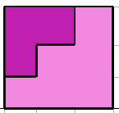


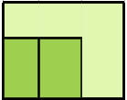
FOR T.V.
S.V.
F.V.
ORTHOGRAPHIC PROJECTIONS
FRONT VIEW
L.H.SIDE VIEW
FOR F.V.
FOR S.V.
x
y
PICTORIAL PRESENTATION IS GIVEN
DRAW THREE VIEWS OF THIS OBJECT
BY FIRST ANGLE PROJECTION METHOD
TOP VIEW

Slide 12



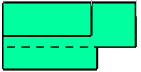
FOR T.V.
S.V.
F.V.
ORTHOGRAPHIC PROJECTIONS
FRONT VIEW
L.H.SIDE VIEW
X
Y
FOR S.V.
FOR F.V.
TOP VIEW
PICTORIAL PRESENTATION IS GIVEN
DRAW THREE VIEWS OF THIS OBJECT
BY FIRST ANGLE PROJECTION METHOD

Slide 13

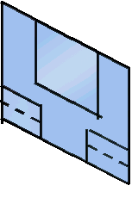
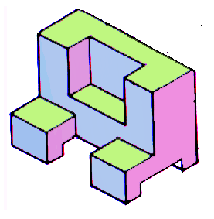
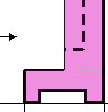
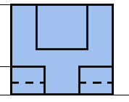
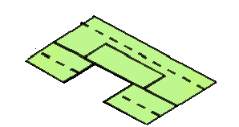

FOR T.V.
S.V.
F.V.
ORTHOGRAPHIC PROJECTIONS
FRONT VIEW
L.H.SIDE VIEW
FOR S.V.
FOR F.V.
X
Y
TOP VIEW
PICTORIAL PRESENTATION IS GIVEN
DRAW THREE VIEWS OF THIS OBJECT
BY FIRST ANGLE PROJECTION METHOD

Slide 14
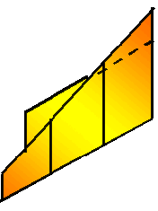
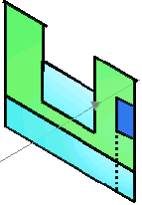

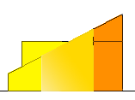



FOR T.V.
S.V.
F.V.
ORTHOGRAPHIC PROJECTIONS
FRONT VIEW
L.H.SIDE VIEW
X
Y
FOR S.V.
FOR F.V.
TOP VIEW
PICTORIAL PRESENTATION IS GIVEN
DRAW THREE VIEWS OF THIS OBJECT
BY FIRST ANGLE PROJECTION METHOD

Slide 15


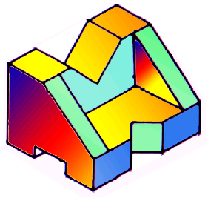




FOR T.V.
F.V.
S.V.
ORTHOGRAPHIC PROJECTIONS
FRONT VIEW
L.H.SIDE VIEW
FOR S.V.
FOR F.V.
X
Y
PICTORIAL PRESENTATION IS GIVEN
DRAW THREE VIEWS OF THIS OBJECT
BY FIRST ANGLE PROJECTION METHOD
TOP VIEW

Slide 16
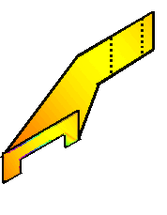

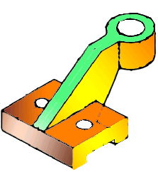
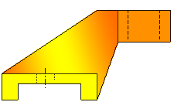
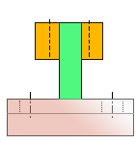
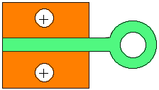
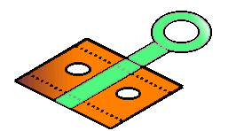
FOR T.V.
F.V.
S.V.
ORTHOGRAPHIC PROJECTIONS
FRONT VIEW
L.H.SIDE VIEW
X
Y
FOR S.V.
FOR F.V.
TOP VIEW
PICTORIAL PRESENTATION IS GIVEN
DRAW THREE VIEWS OF THIS OBJECT
BY FIRST ANGLE PROJECTION METHOD

Slide 17
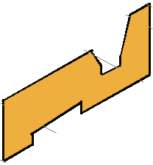

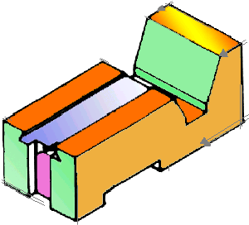
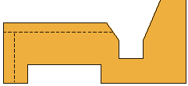
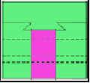
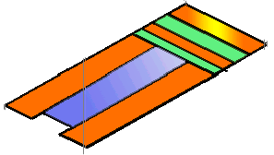
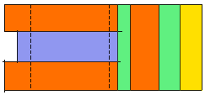
FOR T.V.
S.V.
F.V.
ORTHOGRAPHIC PROJECTIONS
FRONT VIEW
L.H.SIDE VIEW
FOR F.V.
FOR S.V.
X
Y
PICTORIAL PRESENTATION IS GIVEN
DRAW THREE VIEWS OF THIS OBJECT
BY FIRST ANGLE PROJECTION METHOD
TOP VIEW

Slide 18
FOR T.V.
ORTHOGRAPHIC PROJECTIONS
35
FV
35
x
10
y
10
20
30
FOR F.V.
40
70
TV
O
PICTORIAL PRESENTATION IS GIVEN
DRAW FV AND TV OF THIS OBJECT
BY FIRST ANGLE PROJECTION METHOD

Slide 19
FOR T.V.
ORTHOGRAPHIC PROJECTIONS
FV
30
10
30
SV
30
10
30
x
y
FOR S.V.
FOR F.V.
TV
ALL VIEWS IDENTICAL
PICTORIAL PRESENTATION IS GIVEN
DRAW THREE VIEWS OF THIS OBJECT
BY FIRST ANGLE PROJECTION METHOD

Slide 20
FOR T.V.
ORTHOGRAPHIC PROJECTIONS
ALL VIEWS IDENTICAL
FV
SV
x
y
10
FOR S.V.
FOR F.V.
40
60
PICTORIAL PRESENTATION IS GIVEN
DRAW THREE VIEWS OF THIS OBJECT
BY FIRST ANGLE PROJECTION METHOD
40
TOP VIEW
60

Slide 21
ORTHOGRAPHIC PROJECTIONS
FRONT VIEW
L.H.SIDE VIEW
30 SQUARE
40
20
50
FOR F.V.
20
FOR S.V.
X
10
Y
O
30
F.V.
60
S.V.
PICTORIAL PRESENTATION IS GIVEN
DRAW FV AND SV OF THIS OBJECT
BY FIRST ANGLE PROJECTION METHOD

Slide 22
FOR T.V.
ORTHOGRAPHIC PROJECTIONS
FV
40
X
10
Y
O
30 D
45
FOR F.V.
O
10
50
PICTORIAL PRESENTATION IS GIVEN
DRAW FV AND TV OF THIS OBJECT
BY FIRST ANGLE PROJECTION METHOD
80
TV

Slide 23

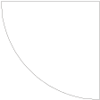
FOR T.V.
ORTHOGRAPHIC PROJECTIONS
FV
40
X
O
10
Y
100
10
25
TV
FOR F.V.
10
30
10
25
30 R
O
20 D
PICTORIAL PRESENTATION IS GIVEN
DRAW FV AND TV OF THIS OBJECT
BY FIRST ANGLE PROJECTION METHOD

Slide 24
PICTORIAL PRESENTATION IS GIVEN
DRAW FV AND TV OF THIS OBJECT
BY FIRST ANGLE PROJECTION METHOD
ORTHOGRAPHIC PROJECTIONS
FOR T.V.
30
FV
RECT.
SLOT
10
50
35
10
Y
X
20 D
FOR F.V.
TV
60 D
30 D
TOP VIEW
O

Slide 25
ORTHOGRAPHIC PROJECTIONS
10
25
15
25
40
10
25
FOR S.V.
FOR F.V.
25
O
O
80
25
F.V.
S.V.
PICTORIAL PRESENTATION IS GIVEN
DRAW FV AND SV OF THIS OBJECT
BY FIRST ANGLE PROJECTION METHOD

Slide 26
FOR T.V.
ORTHOGRAPHIC PROJECTIONS
45⁰
30
FV
40
X
Y
30 D
FOR F.V.
40
TV
O
PICTORIAL PRESENTATION IS GIVEN
DRAW FV AND TV OF THIS OBJECT
BY FIRST ANGLE PROJECTION METHOD
15
40

